Slide 1
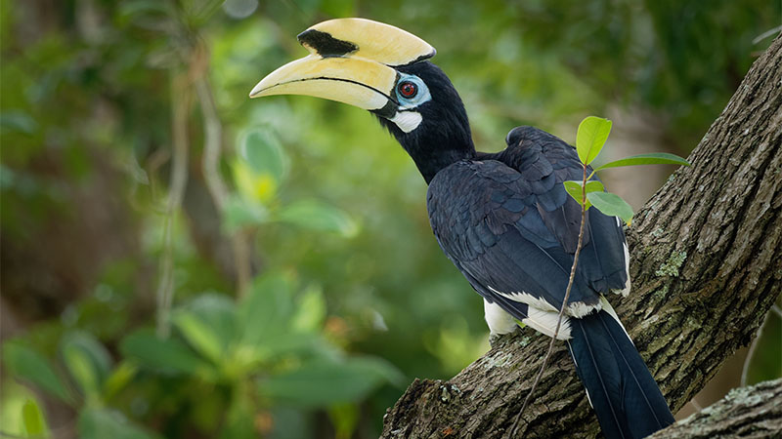
Enhancing Bird Species Recognition and
Education for Singapore
A Regional Acoustic Classifier and RAG-Based Assistant
Presenter: Adele Ng Jingwen
Supervisor: Dr. Owen Noel Newton Fernando
Institution: College of Computing and Data Science, NTU
Year: 2026
Notes:
This work represents a crucial step in leveraging AI for local biodiversity conservation for singapore, which is a field still relatively unexplored.

Slide 2
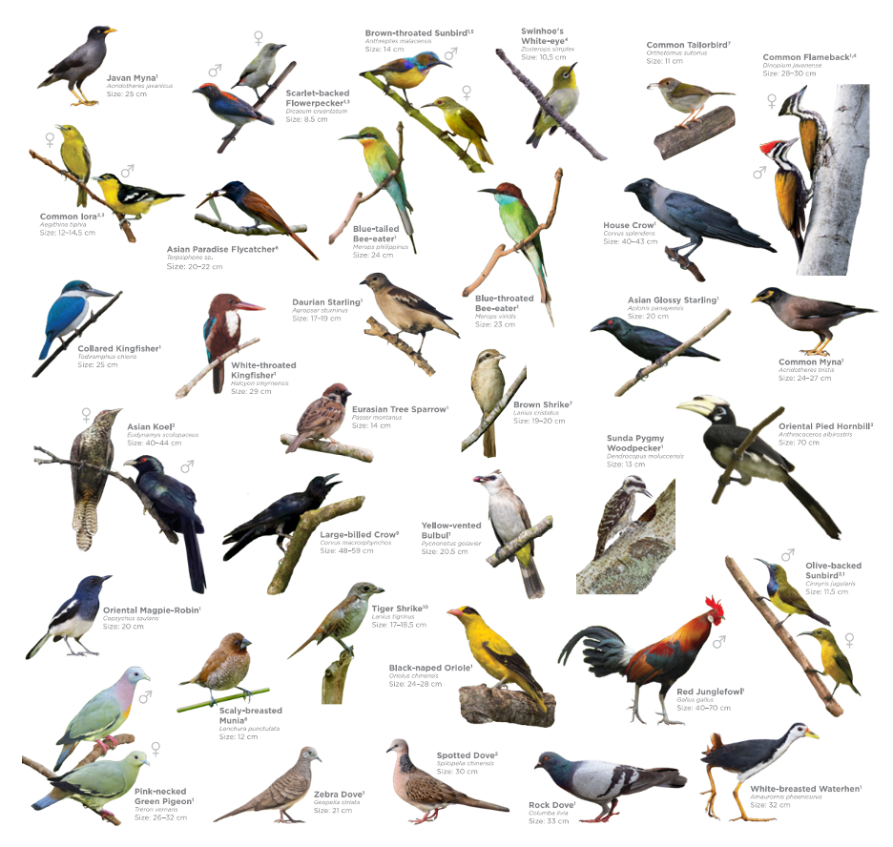
Notes:
- which hear by sound alone?
- house crow, rooster, asian koel (infamous morning calls)
- recently been able to recognise black-naped oriole calls too as there is a pair living right outside my window.
- birds give us a lot of information about ecological environment. to assist with efficient monitoring, we use detect them using their sound

Slide 3

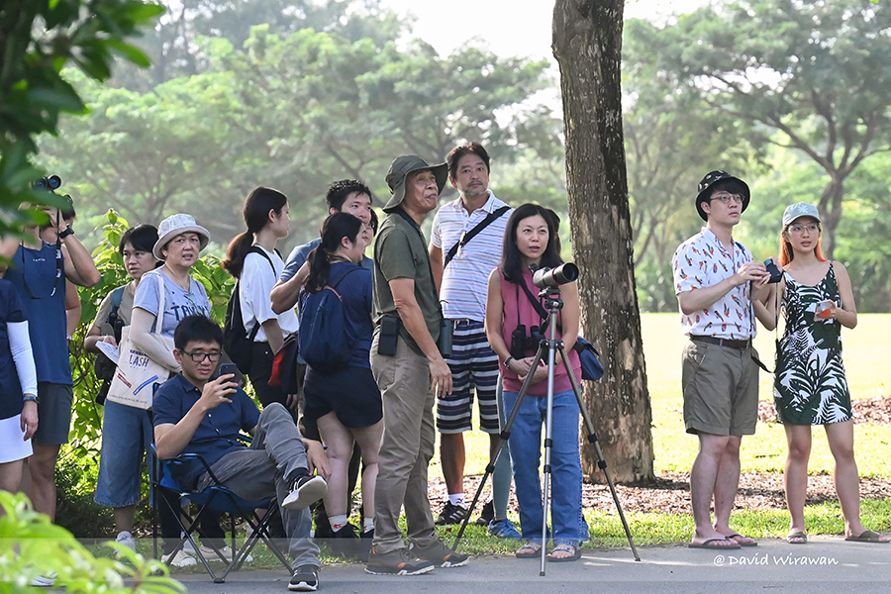


Urban Biodiversity Monitoring Barriers
Context: Singapore's "City in Nature" vision taps on programmes like NParks Garden Bird Watch for large-scale data.
Effective citizen science in Singapore is hindered by a critical gap between ecological vision and technical accessibility.
Identification Barrier: Non-experts struggle with acoustic recognition.
Knowledge Gap: Authoritative ecological data is often siloed in static reports, lacking the interactive accessibility needed for public education.
Notes:
citizen can assist in provision of ecological data, not just professionals only.

Slide 4
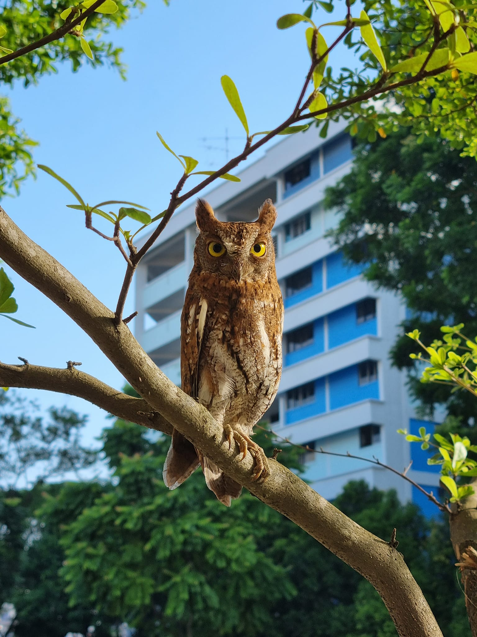


Urban Biodiversity Monitoring Barriers
Project Goal: Develop reusable AI components to bridge these gaps through regional model adaptation and RAG-based assistance.
Audience: Citizen scientists who require both identification tools and contextual learning to remain engaged.
"Regional fine-tuning and grounded retrieval
Notes:
. Our project aims to bridge these gaps by developing reusable AI components, specifically through regional model adaptation and a Retrieval-Augmented Generation system

Slide 5
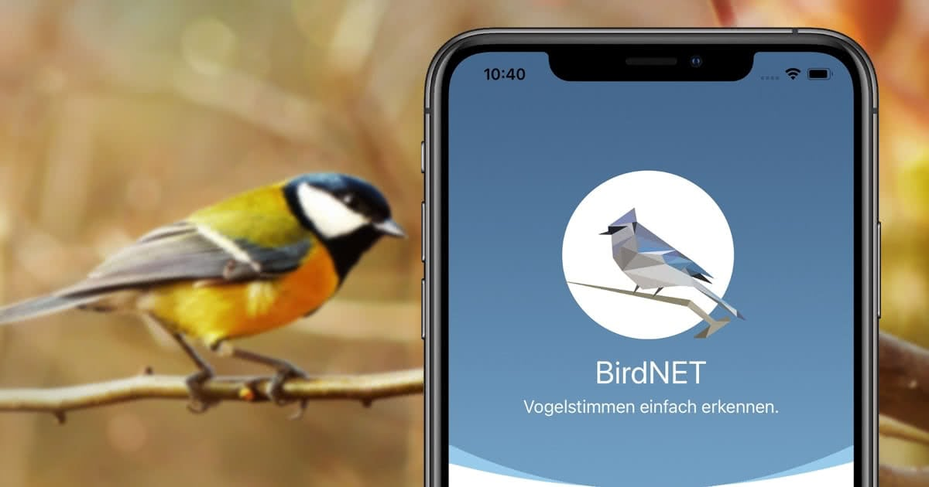
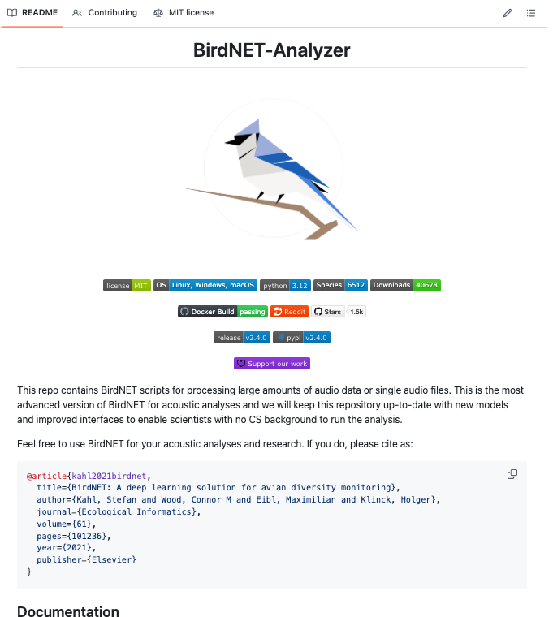
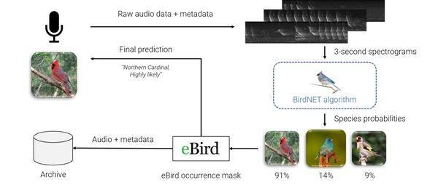
Notes:
most popular bird recognition tools globally. it is a model developed by cornell.
- interesting thing about this is that their scripts are open-sourced readily available on github. we can use it to adapt our models

Slide 6




Global Models vs. Local Soundscapes
Baseline BirdNET V2.4 achieves only 32.1% accuracy on common Singapore garden birds, highlighting the critical need for regional adaptation.
Domain Shift
Acoustic Divergence
Global models are heavily biased toward North American and European species, leading to suboptimal performance in Southeast Asia.
Regional dialects and urban noise profiles in Singapore may differ significantly from the model's original training distribution.
No-Detection Rate
Performance Gap
38.3% of samples failed to trigger any confident prediction, rendering the model unreliable for automated monitoring.
37% of target Singapore species (10/27) had a 0% recognition rate in baseline tests, indicating complete failure for many local birds.
Notes:
Our baseline tests with BirdNET V2.4 on common Singapore garden birds revealed a stark reality: only 32.1% accuracy.
-This performance gap is could be due to domain shift; these models trained heavily are biased towards North American and European species. - We observed a complete failure for many local birds, with 37% of our target species showing a 0% recognition rate. Even more concerning, 38.3% of samples yielded no confident prediction at all, rendering the model unreliable for automated monitoring. -So, how do we address this significant performance deficit?

Slide 7
Urban Biodiversity Monitoring Barriers
KEY INSIGHT
Regional fine-tuning and grounded retrieval can enhance citizen participation in bird monitoring, making citizen science viable for local conservation efforts.
Notes:
we can do this!

Slide 8
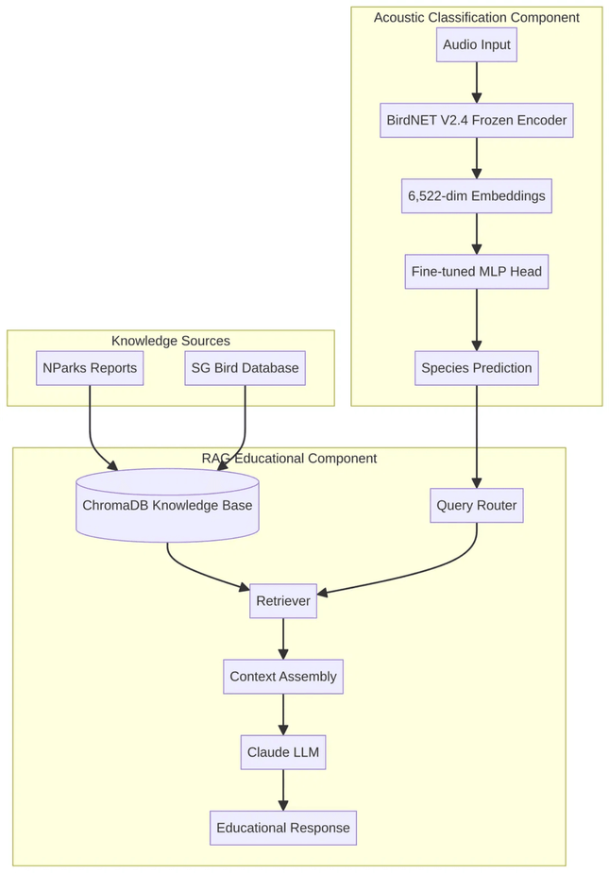
Dual-Component System Architecture
The system proposes a fine-tuned MLP classifier and a RAG-based educational pipeline for end-to-end recognition and learning.
1
Feature Extraction
6,522-dimensional embeddings extracted from a frozen BirdNET V2.4 encoder.
2
Local Classification
Fine-tuned MLP head trained on Singapore-specific species labels.
3
Contextual Retrieval
Semantic search over NParks and SG Bird Database via ChromaDB.
4
Educational Response
Grounded generation using Claude LLM with retrieved local context.
Notes:
To tackle these challenges, we've designed a dual-component system architecture that integrates both recognition and education. - This system is built on two main pillars: a fine-tuned Multi-Layer Perceptron classifier and a RAG-based educational assistant. - The workflow is straightforward: audio input is processed for feature extraction, then classified by our local model. This classification then triggers contextual retrieval from a curated knowledge base, leading to an educational response. - Now, let's dive deeper into how we achieve this local classification through transfer learning.

Slide 9

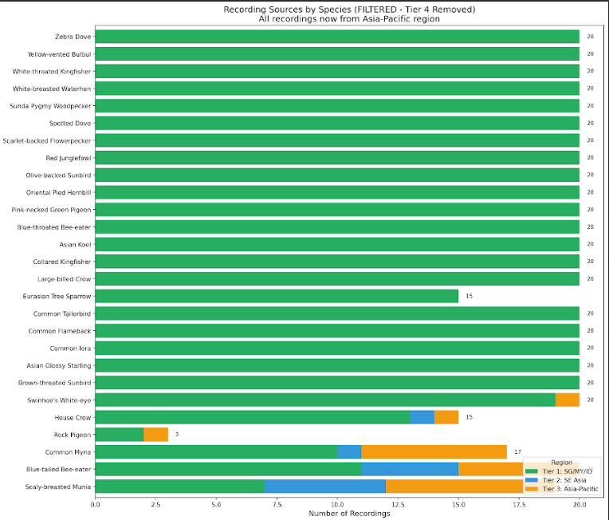

Transfer Learning & Data Strategy
PHASE 1: CLASSIFICATION
Data Augmentation Strategy
Extracting data from xeno-canto
Time Shift (±0.3s)
Pitch Up (+2 semitones)
Volume (-30%)
Pitch Down (-2 semitones)
Gaussian Noise
Volume (+30%)
Dataset Composition
Partition
Original
Augmented
Training
354
2,124
Hidden Layers: 2 layers with Batch Normalization
Validation
74
0
Regularization: Dropout (0.3) + Weight Decay (10⁻⁴)
Output: Softmax over 27 Singapore species
Test
81
0
Total
509
2,124
Notes:
We got our data from xeno canto
To further enhance our model's robustness, we employed extensive data augmentation techniques, including time shifting, pitch adjustments, volume changes, and the addition of Gaussian noise.
This approach allows us to adapt global embeddings to our specific regional species effectively.

Slide 10
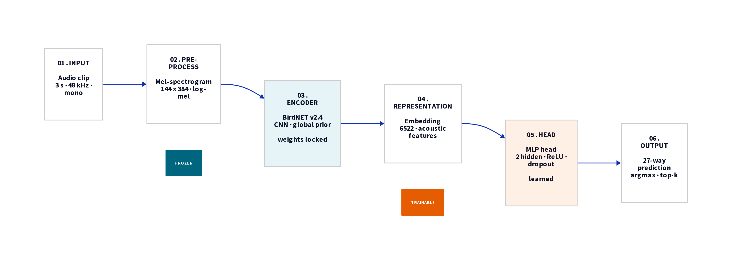
Transfer Learning & Data Strategy
PHASE 1: CLASSIFICATION
Adapting Global Embeddings
Leveraging BirdNET V2.4 as a frozen feature extractor to overcome regional data scarcity. This approach utilizes high-level acoustic patterns learned from 6,000+ global species.
Notes:
Our classification phase heavily relies on transfer learning, a crucial strategy for overcoming data scarcity in regional bioacoustics.
- add audio data, transform into spectrogram images - We leverage the BirdNET V2.4 encoder as a frozen feature extractor, . This allows us to utilize the high-level acoustic patterns learned from thousands of global species.
- We then train a specialized Multi-Layer Perceptron head on these features, consisting of three layers with batch normalization and dropout to prevent overfitting

Slide 11
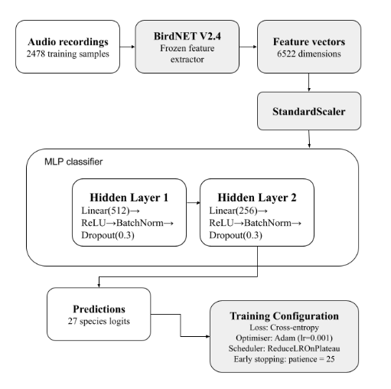
Notes:
Input: 6,522-dimensional logits (BirdNET output)
Hidden Layers: 2 layers with Batch Normalization
Regularization: Dropout (0.3) + Weight Decay (10⁻⁴)
Output: Softmax over 27 Singapore species

Slide 12
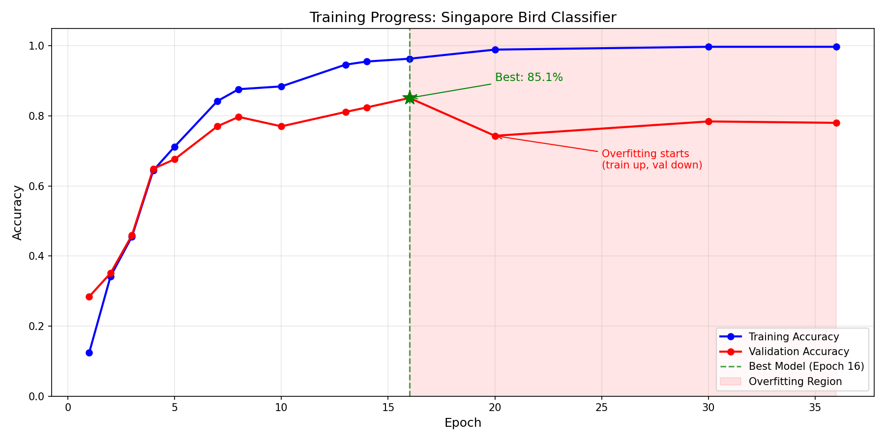

Slide 13
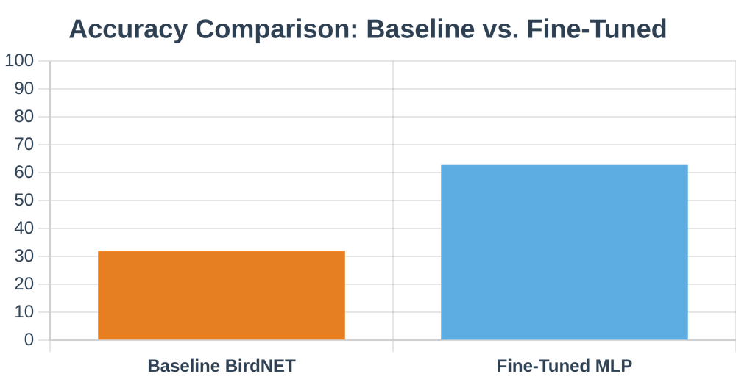



Fine-Tuning Nearly Doubles Accuracy
PERFORMANCE GAIN
32.1% → 63.0%
Regional adaptation through feature-based transfer learning demonstrates a substantial improvement in identifying Singapore's garden birds.
Absolute Gain: 30.9 percentage point increase in overall classification accuracy.
Species Coverage: 18 out of 27 species showed improved recognition; many rose from 0% to >50%.
Robustness: 5-fold cross-validation confirmed stable performance (Mean: 62.7%, SD: 6.3%).
Technical Interpretation
Notes:
"Adapting pretrained acoustic representations to a regional context successfully recovers discriminative features for previously unrecognised local vocalisations"
Fine-tuning nearly doubles our classification accuracy. This is a significant gain, moving from 32.1% to 63.0% overall. We saw improved recognition for 18 out of 27 species. Many of these species previously had zero recognition. This demonstrates the robustness of our approach. We confirmed stable performance with 5-fold cross-validation.

Slide 14
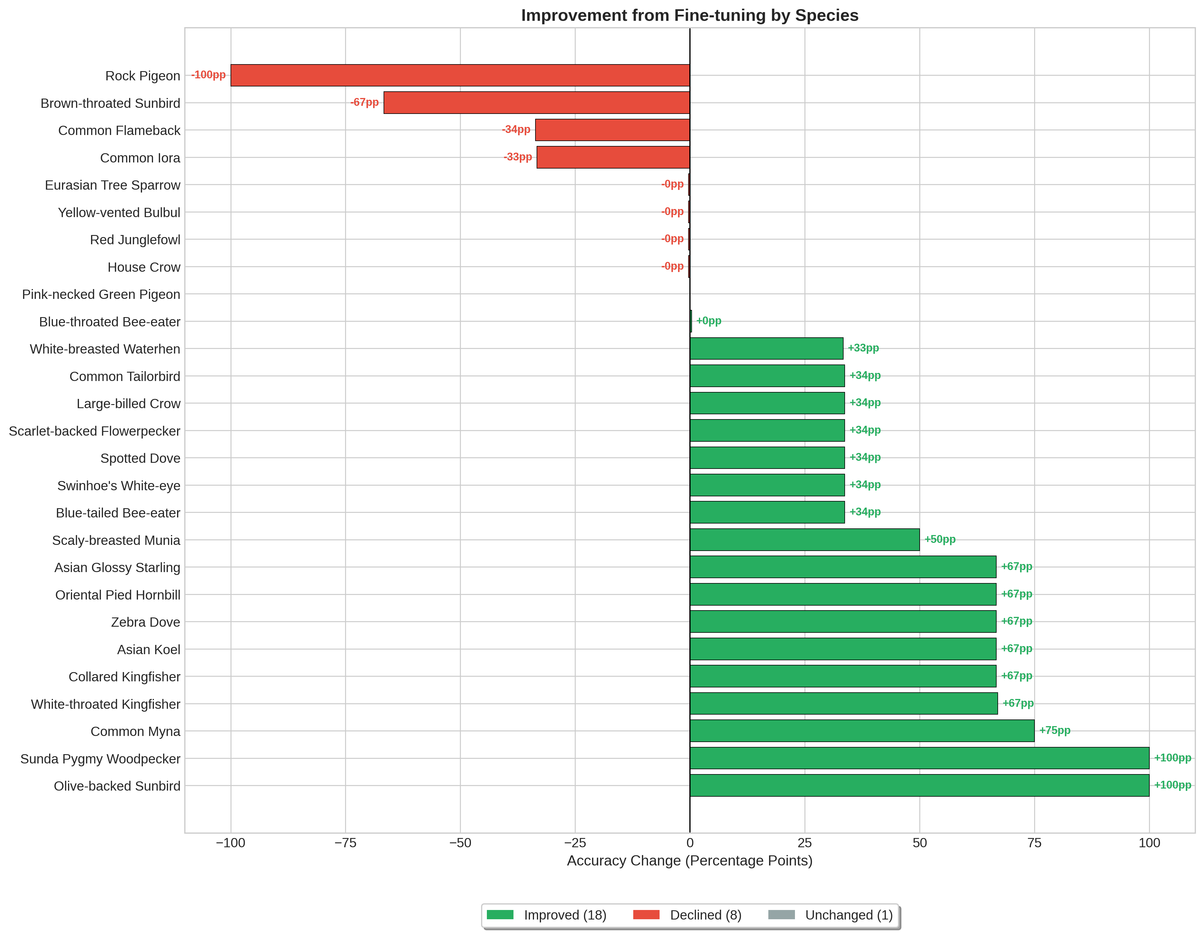

Slide 15
Urban Biodiversity Monitoring Barriers
Technical Interpretation
Adapting pretrained acoustic representations to a regional context can recover discriminative features for previously unrecognised local vocalisations.

Slide 16

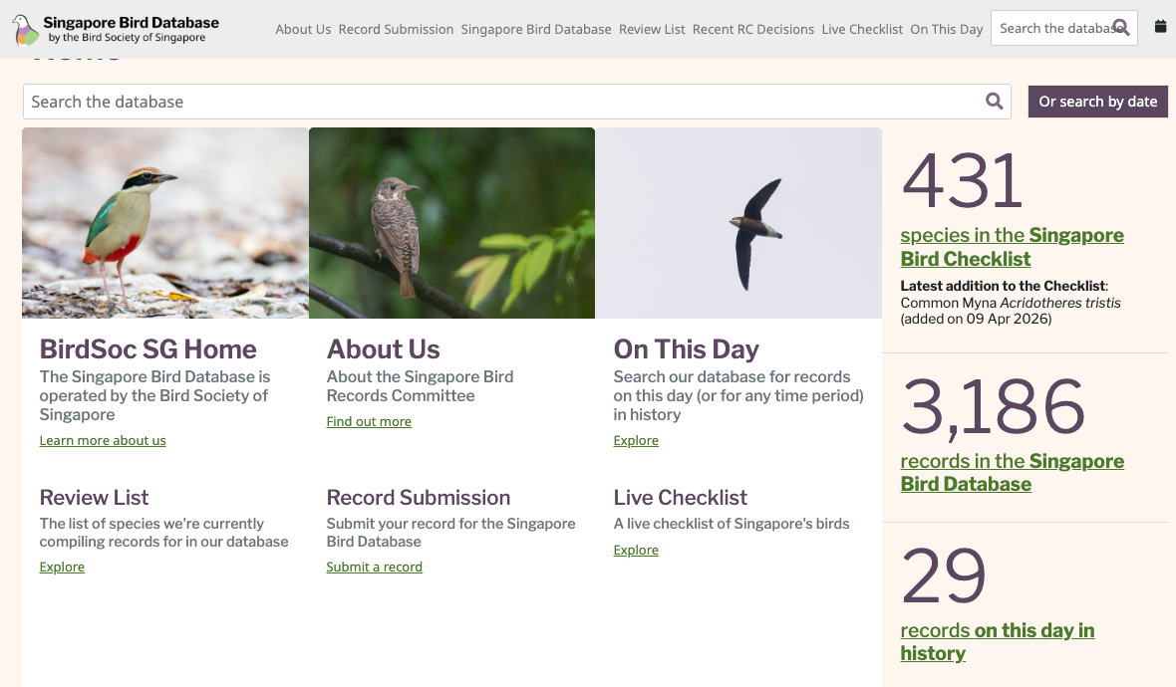
RAG Pipeline: Grounding Education
KNOWLEDGE BASE
Curated Local Sources
The RAG pipeline eliminates hallucinations by sourcing information from authoritative Singaporean ecological databases rather than relying on general LLM.
Notes:
Following our improved classification, we need to provide accurate information. Our RAG pipeline grounds educational responses in local authority. This eliminates hallucinations by sourcing from NParks and local databases. We curated our knowledge base from NParks Garden Bird Watch reports and the Singapore Bird Database.

Slide 17
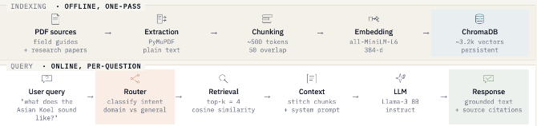
RAG Pipeline: Grounding Education
Technical Stack
Embeddings: all-MiniLM-L6-v2
Vector DB: ChromaDB
LLM: Claude 4 Sonnet
Routing: Hybrid Keyword/Semantic
Notes:
Our technical stack uses Sentence-Transformers for embeddings and ChromaDB for vector storage. We then use Claude 4 Sonnet for generation. This setup ensures highly relevant and factual information. Now, let's see how well this pipeline performs.

Slide 18
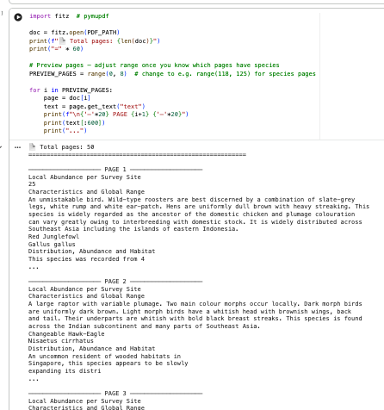
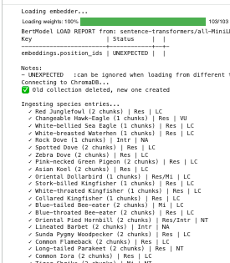
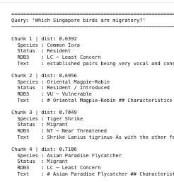
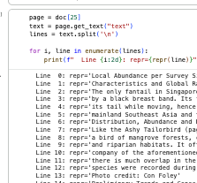
Notes:
before we feed all these data in we had to first analyse our data
by page, by line
split by species and perform embedding
run chunks through test queries. not very accurate. LLM comes in because it understand context instead of just a simple similarity search.

Slide 19
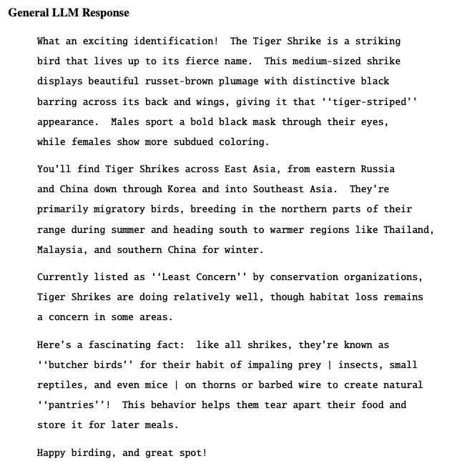
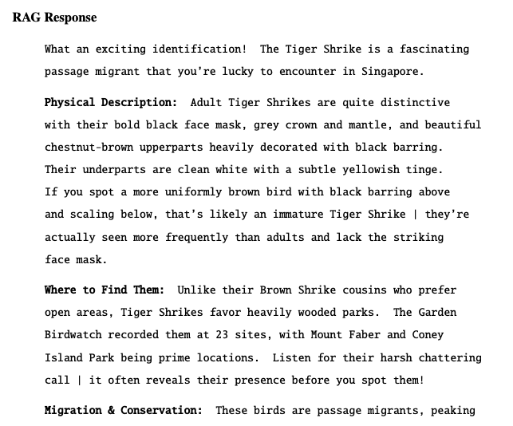

Standalone LLM
RAG-Based Assistant
Notes:
we integrated LLM into our response
compare a standard LLM vs RAG based assistent
- scenario where user identified tiger shirke using audio classifer

Slide 20
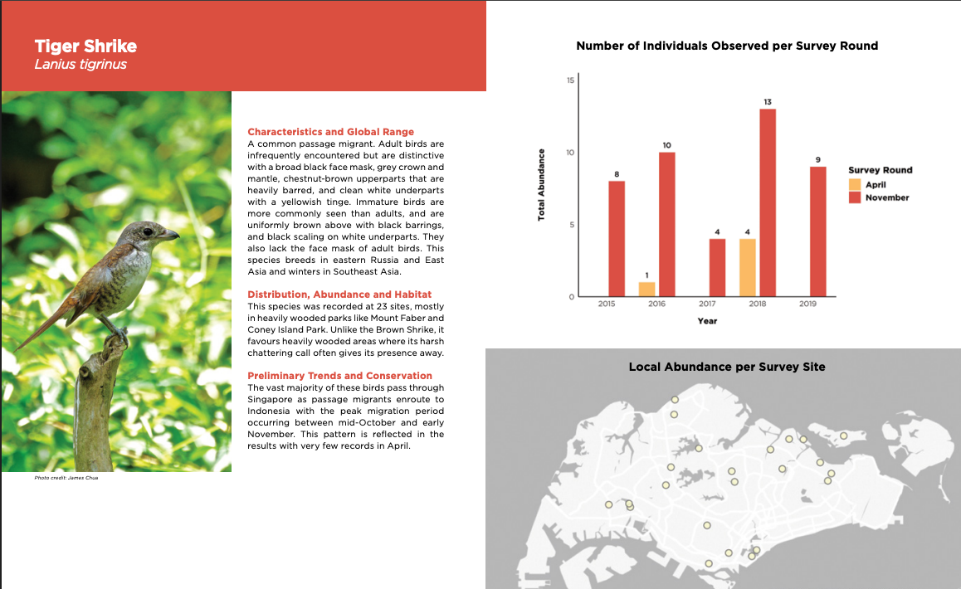
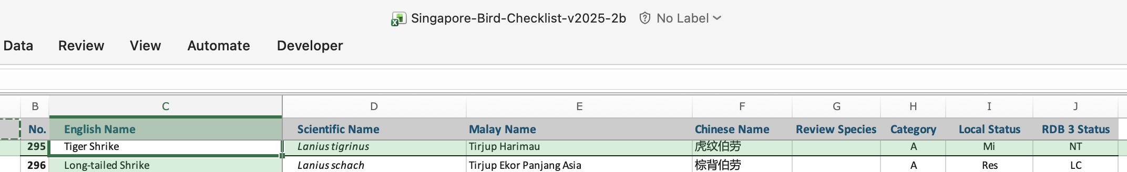

Slide 21
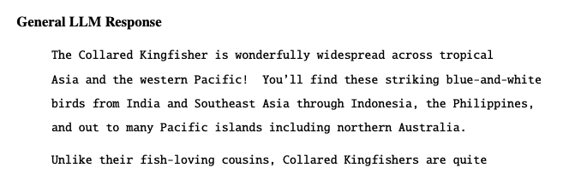
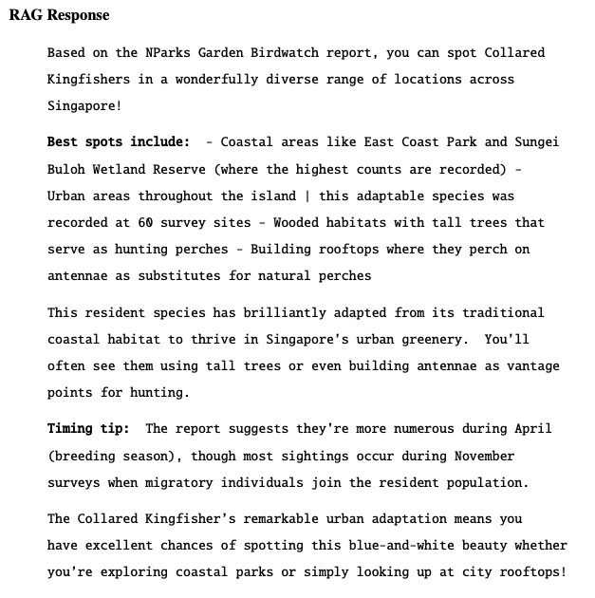
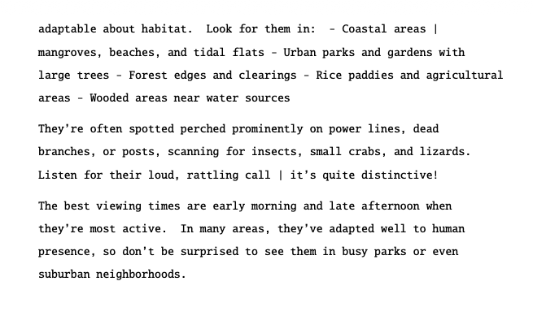
Standalone LLM
RAG-Based Assistant

Slide 22
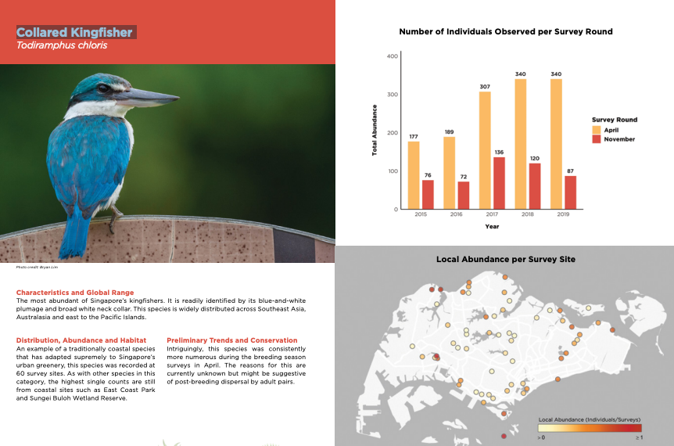
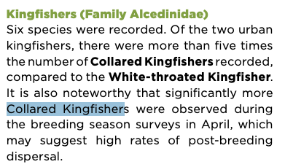
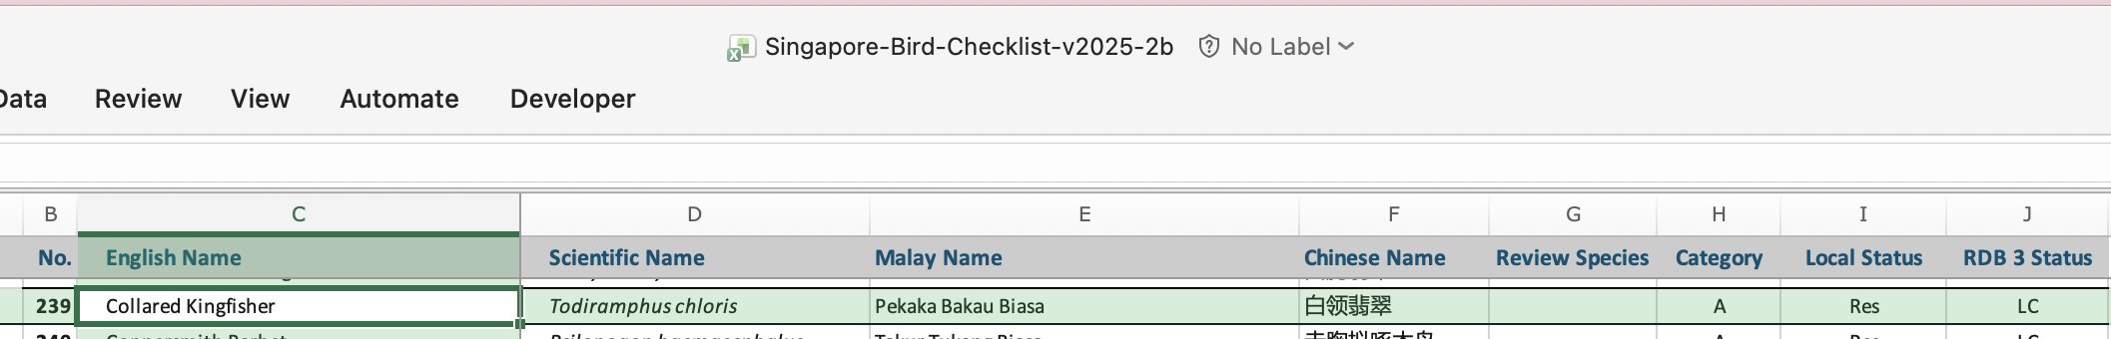

Slide 23


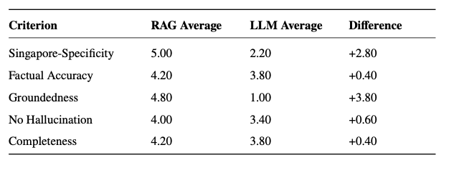
Evaluation: Factuality & Local Relevance
The RAG pipeline was evaluated using an LLM-as-a-Judge framework (Claude 4.6 Opus) to assess groundedness and educational value.
Quantitative Metrics
Qualitative Insights
Local Context Retrieval
Successfully identifies specific Singaporean habitats like "Central Catchment Nature Reserve" or "Jurong Lake Gardens."
Source Attribution
All claims are traceable to authoritative sources (NParks, Bird Society of SG), enhancing educational trust.
KEY OBSERVATION
No Hallucination (Faithfulness)
Unlike standalone LLMs, the RAG system distinguishes between similar local subspecies and provides accurate conservation status within the Singapore Red Data Book.
High adherence to retrieved NParks documents; minimal hallucination of species traits.
Singapore-Specificity (Relevance)
Responses directly address user queries with Singapore-specific context.
Notes:
We used an LLM-as-a-Judge framework to assess groundedness. The system achieved high scores for faithfulness and relevance. It successfully retrieves local habitat details. All responses are traceable to authoritative Singaporean ornithological resources.
Completeness has a close fight. RAG responses may not be as complete as LLM sometimes as it depends largely on the grounded dataset vs LLM trained on big data.

Slide 24




Limitations & Future Directions
While the system demonstrates significant gains in regional adaptation, urban bioacoustics in Singapore faces ongoing technical and data-driven challenges.
Urban Noise: Sensitivity to high background noise in Singapore's dense urban environment remains a challenge for clean feature extraction.
Data Scarcity: Limited high-quality local recordings for rare or shy species restricts the classifier's breadth across all 400+ SG species.
Multi-label Detection: Future work will transition from single-species classification to identifying multiple birds in complex, overlapping soundscapes.
Edge Deployment: Exploring lightweight models for real-time, on-device inference to support immediate feedback for citizen scientists.
The roadmap focuses on moving from laboratory validation to real-world,
real-time ecological monitoring tools for Singapore's 'City in Nature' vision.
Notes:
We've seen the strengths of our system. But, like any research, there are limitations and future directions.
Our current system is sensitive to high background noise.
Data scarcity also limits our classifier's breadth.
Future work will focus on multi-label detection.
We also plan to integrate with mobile apps for real-time feedback. This will allow for on-device inference. We'll explore lightweight models for this. Now, let's summarize our contributions.

Slide 25




Contributions to Singapore's Digital Ecology
Technical: A proven methodology for adapting global bioacoustic models to regional contexts with limited data.
Educational: A RAG framework that democratizes access to specialized Singaporean ecological knowledge.
Impact: Lowering the barrier for public engagement in Singapore's "City in Nature" initiatives.
Open Science: Documented, modular components ready for integration into NParks or community platforms.
Notes:
These are the contributions we want to make Singapore's digital ecology.
We provide a proven methodology for adapting global bioacoustic models. We also offer a RAG framework that democratizes access to specialized ecological knowledge. This lowers the barrier for public engagement in Singapore's 'City in Nature' initiatives. Our documented components are ready for integration into existing platforms. This project empowers citizens to become guardians of Singapore's biodiversity.

Slide 26
By combining localized recognition with grounded intelligence, we empower every
citizen to become a guardian of Singapore's biodiversity.

Slide 27
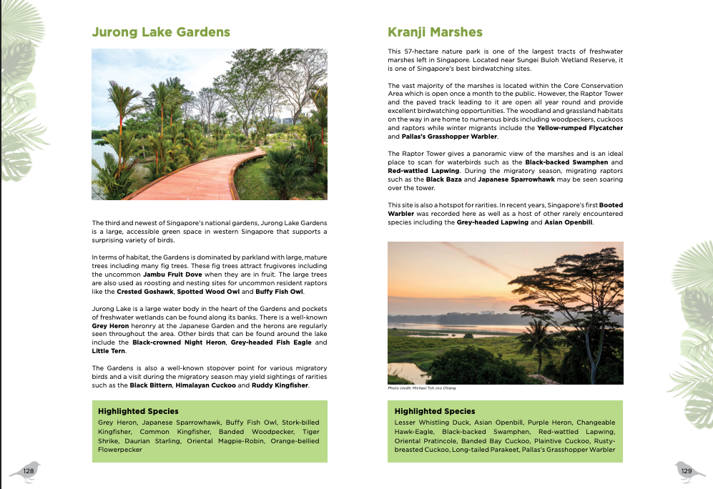

Slide 28


Tropical Bird Sound Recognition with Limited Data TropiCalls – Giving Tropical Birds a Voice
Adele Ng Jingwen
CCDS
8 Nov 2025

Slide 29
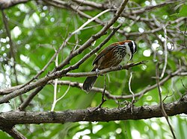
TropiCalls – Giving Tropical Birds a Voice
Host ~75% of the world’s bird species
Vital to biodiversity
But hard to see in dense forests
Rely on sound recording
Tropical Symphony: Rainforests are filled with bird songs – tropical regions host ~90% of the world’s bird species.
Why It Matters: These birds are vital to biodiversity, but they’re hard to see in dense forests (we often hear them instead). Monitoring their calls is key for conservation.
Our Goal: TropiCalls is a project to automatically identify tropical bird species by sound, even with very few recordings of each bird.
Notes:
https://commons.wikimedia.org/wiki/File:Tropical_bird_on_a_branch_(Unsplash).jpg https://commons.wikimedia.org/wiki/File:Taiwan_Scimitar_Babbler_in_Taipei.jpg

Slide 30
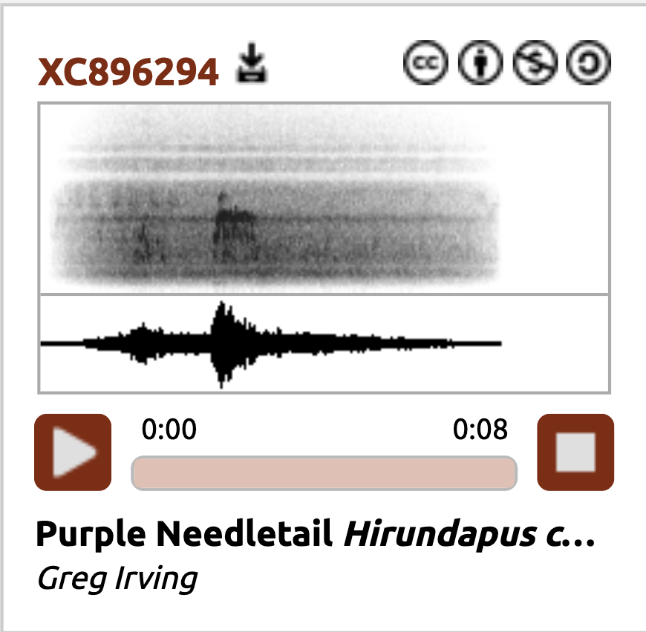
The Challenge
Very few recordings available
Underrepresented compared to temperate species
Modern AI
Few recordings = “invisible” species
BirdNET struggle with local and rare birds
Localising models with Singapore-specific sounds
Slide 2: The Challenge – Scarce Audio Data
Data Gap: Many tropical birds have very few recordings available – some only 5–10 clips in public archives.
Bias in Databases: Most bird sound collections focus on Europe/N. America; tropical species are underrepresented. (E.g., many East African birds are missing from major libraries.)
Why Hard for AI: Modern AI needs lots of examples. Few recordings = “invisible” species for AI models. The richest biodiversity is where data are scarcest.
Notes:
https://xeno-canto.org/article/241

Slide 31
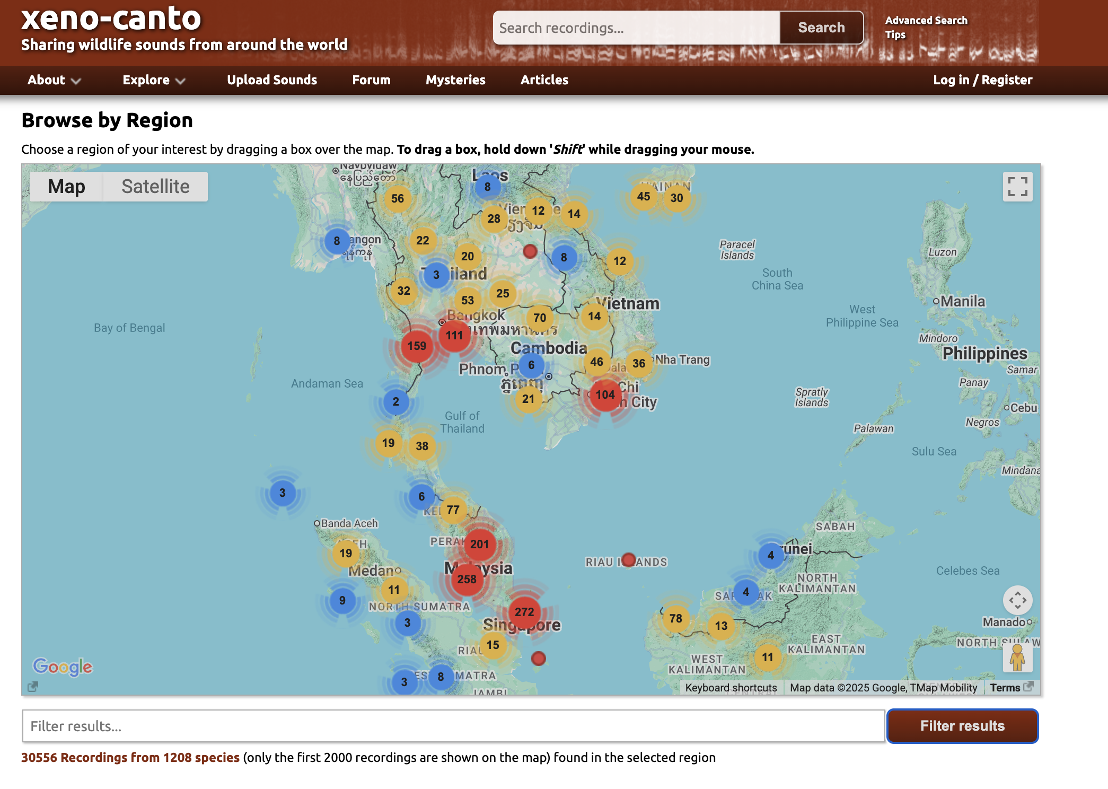
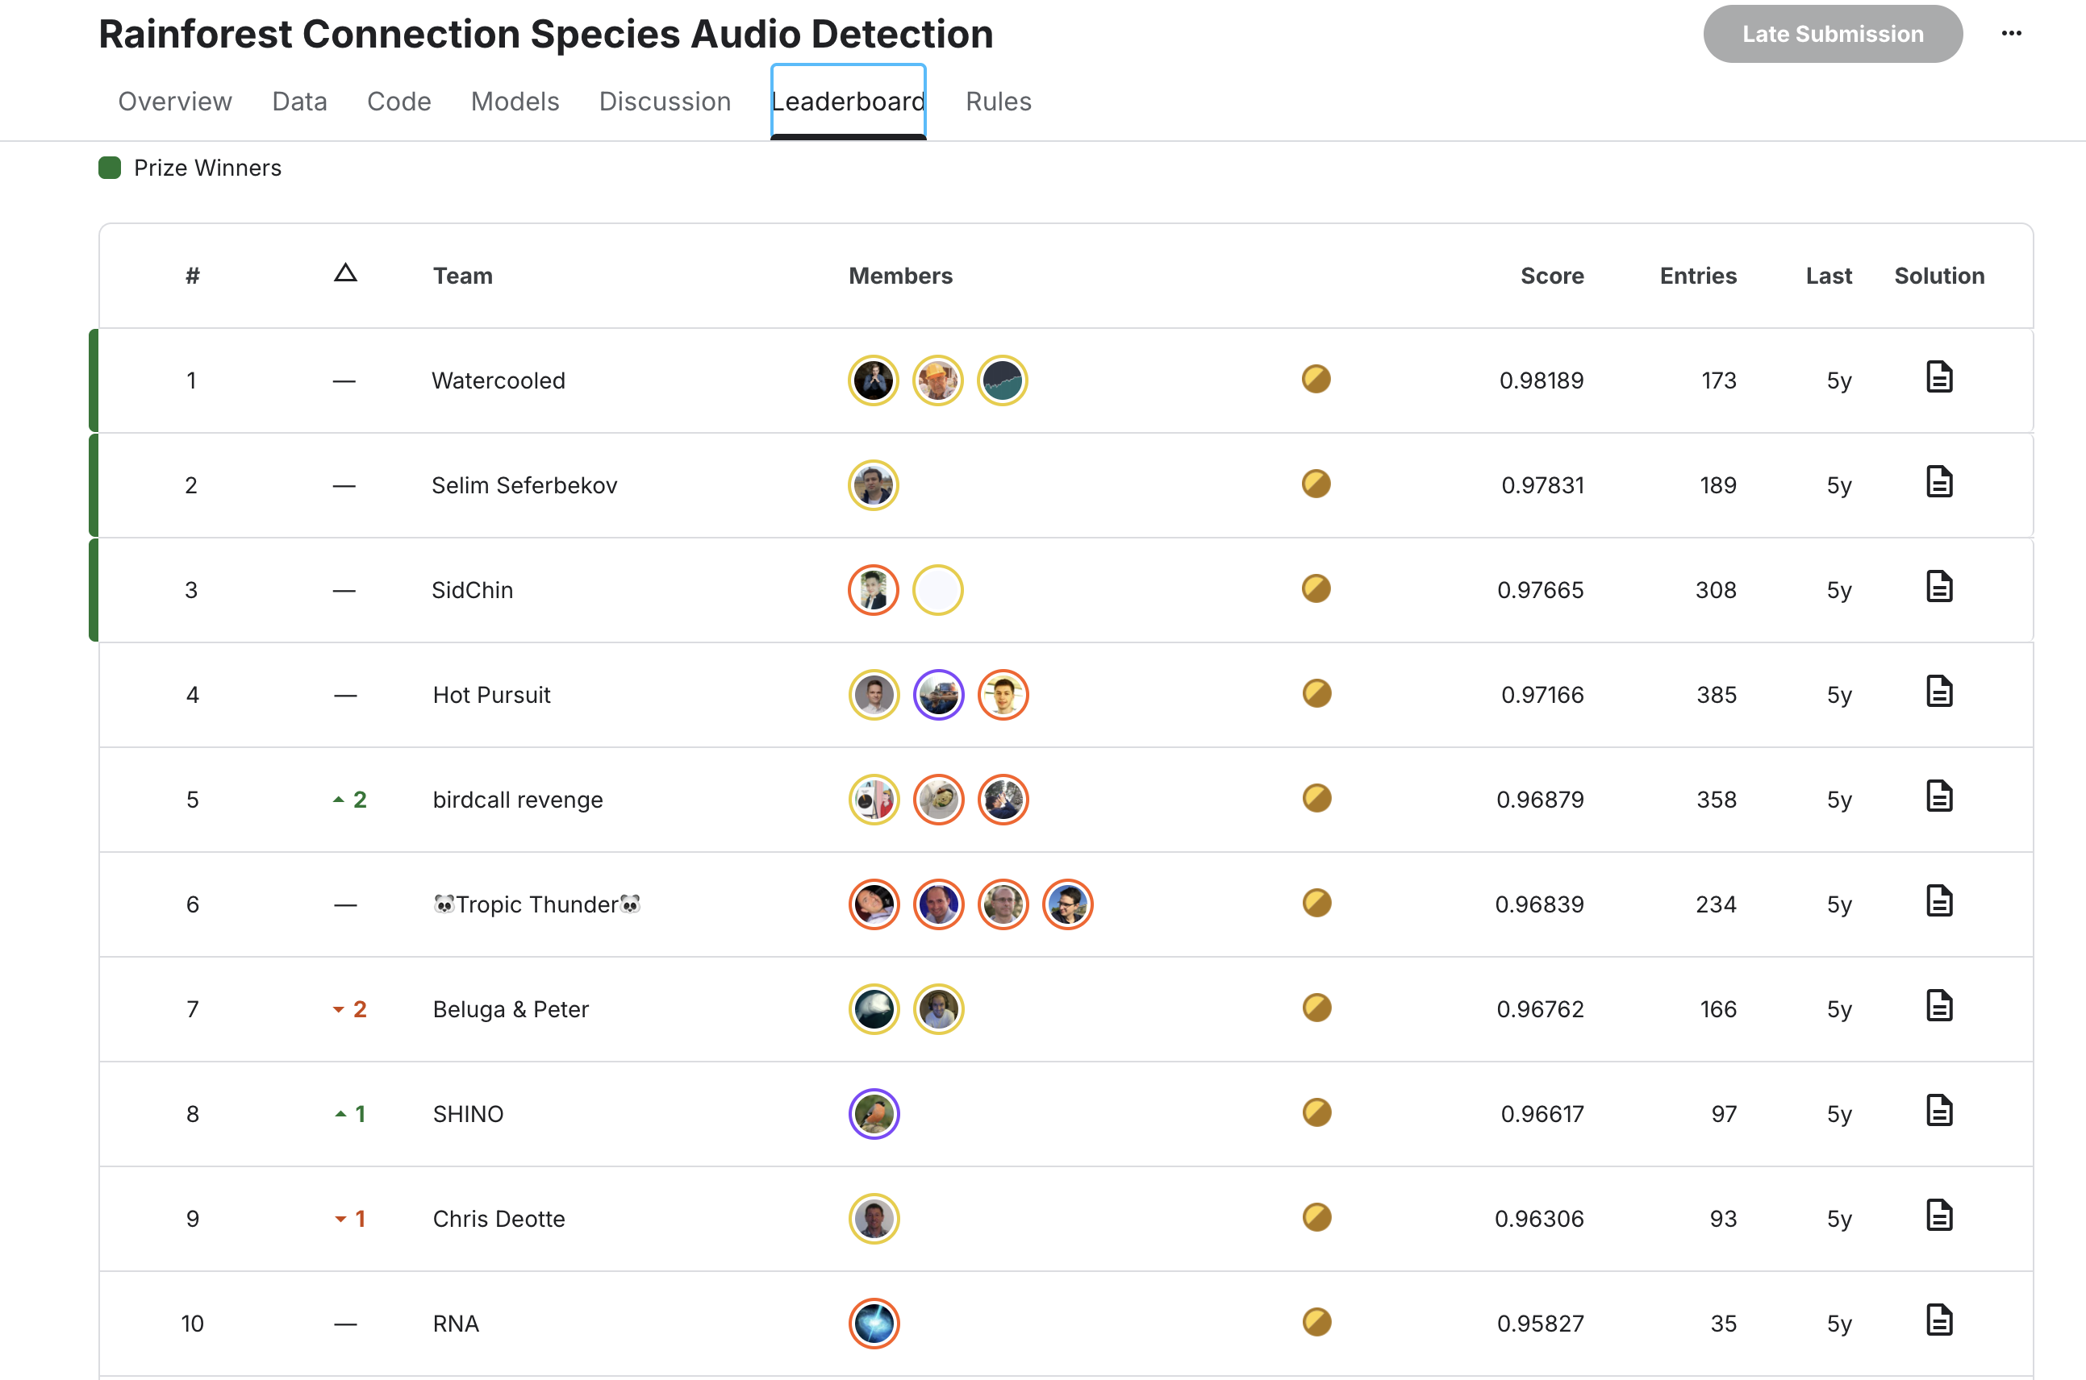
Our Approach
Xeno-cato
Kaggle Rainforest Connection

Slide 32
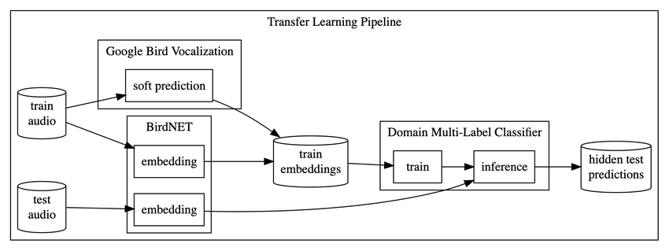
Model Strategies
Applied Transferred Learning on existing models
Use data augmentation to expand the dataset
Fine-tuned using our limited recordings

Slide 33

TropiCall
Despite data limitations
Bridge data gap with clever AI strategies
Future: Extend to more tropical species
Frogs, Insects

